Slide 1
JavaScript Lab 2
JavaScript for React
Notes:
Hello everyone and welcome to this lesson, where we are going to do a quick overview of JavaScript

Slide 2
1 Conditional statements
JavaScript for React

Slide 3
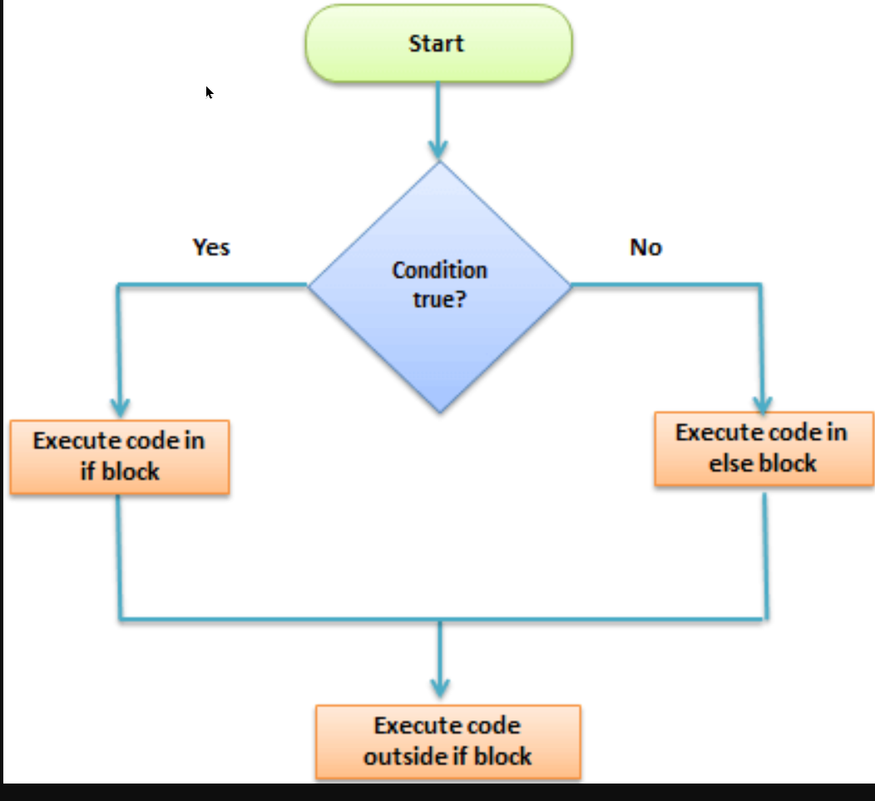
if-else

Slide 4
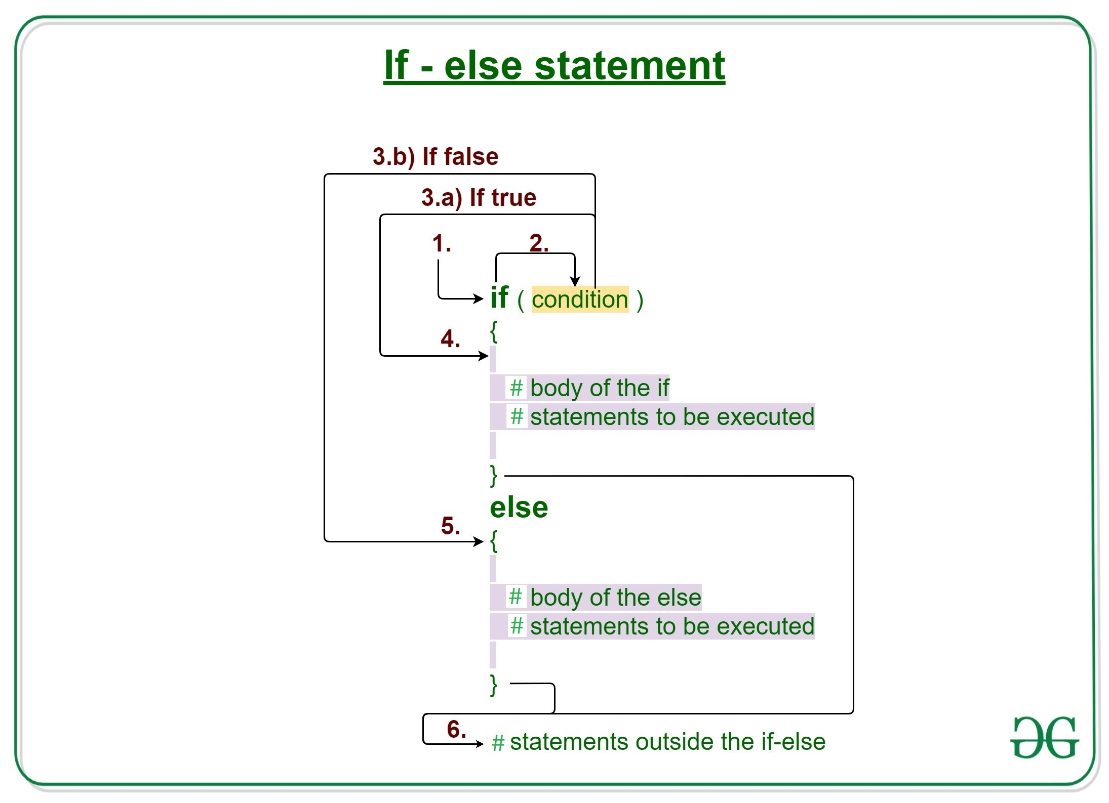

Slide 5
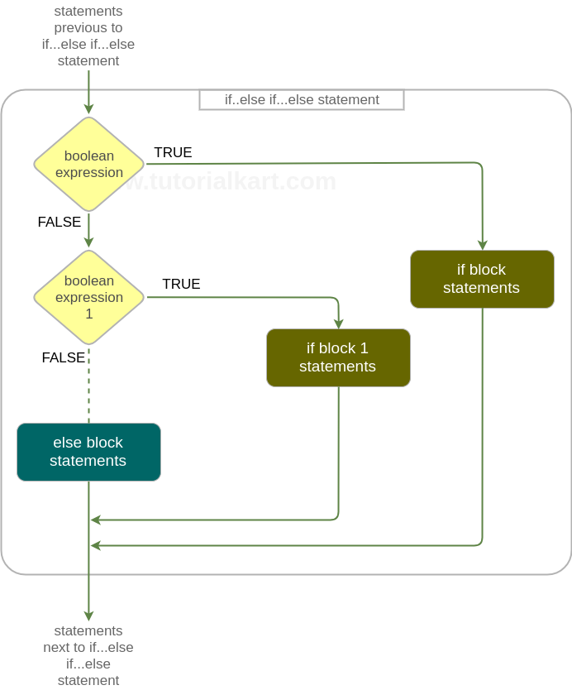
if – else-if

Slide 6
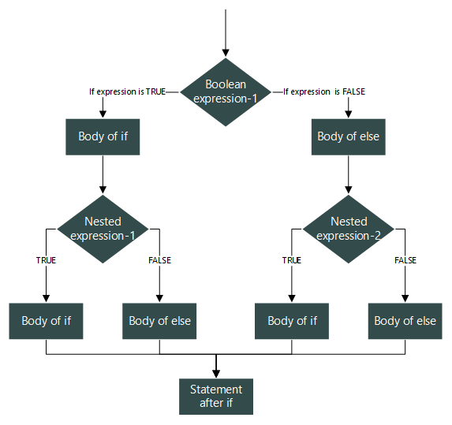
Nested if-else

Slide 7
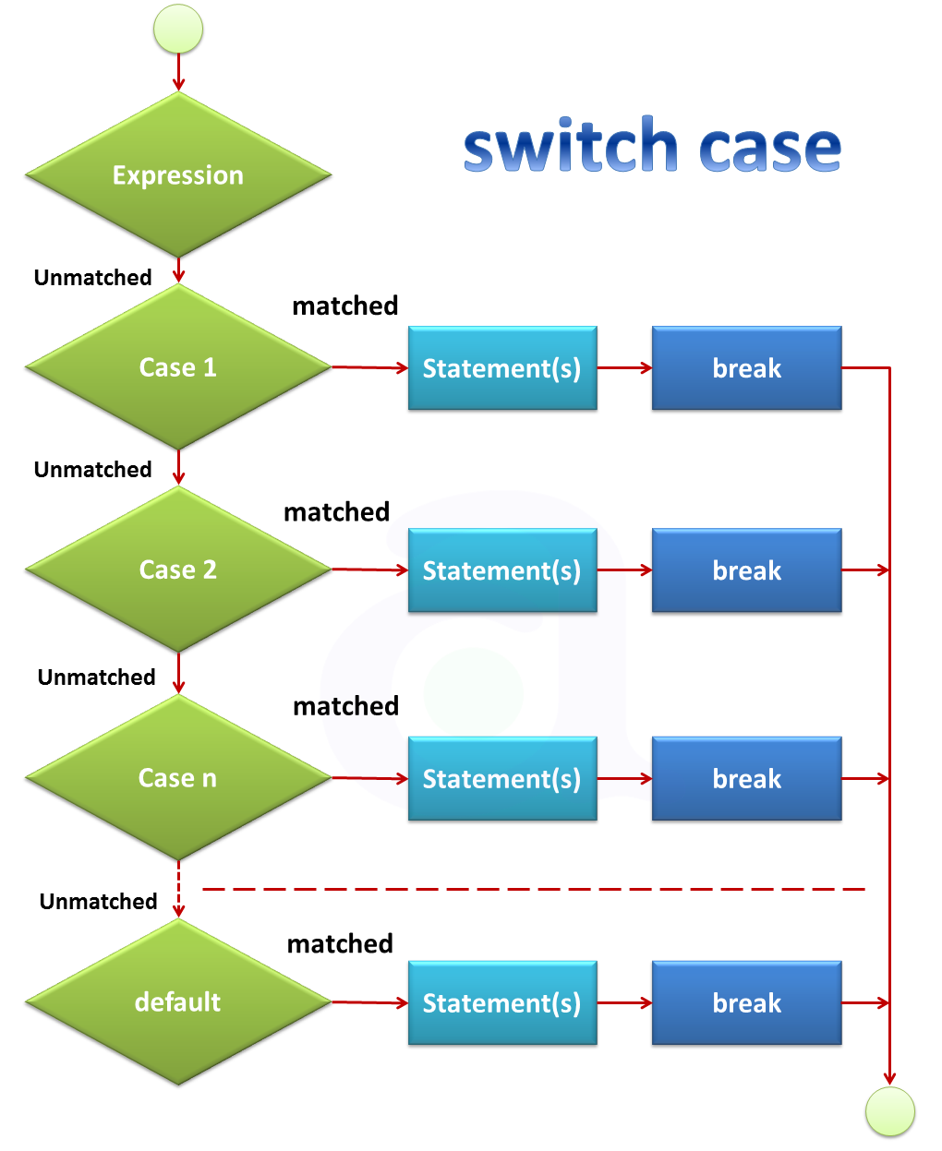

Slide 8
2 Loops
JavaScript for React

Slide 9
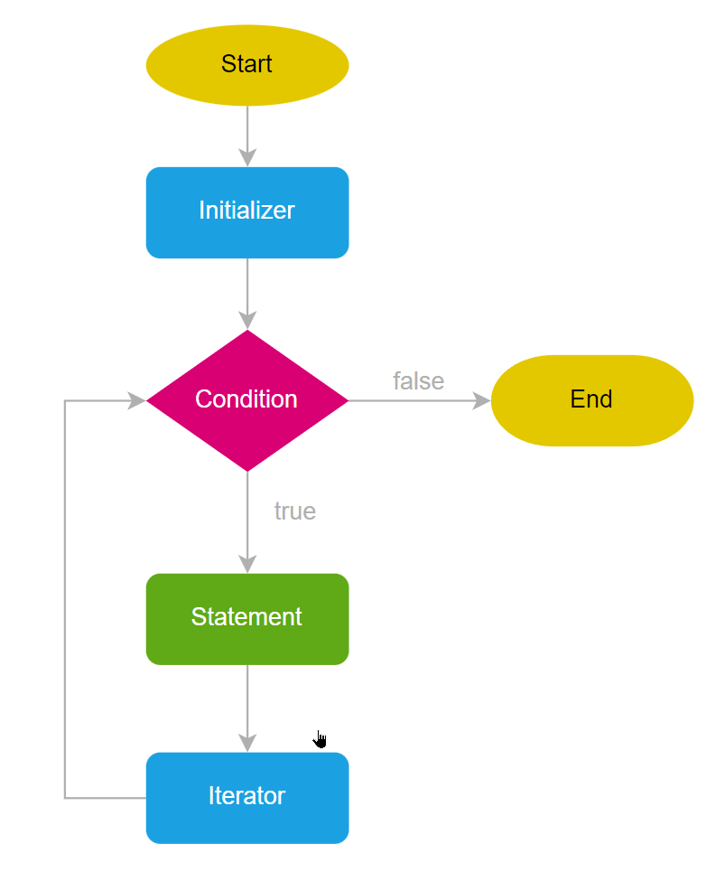
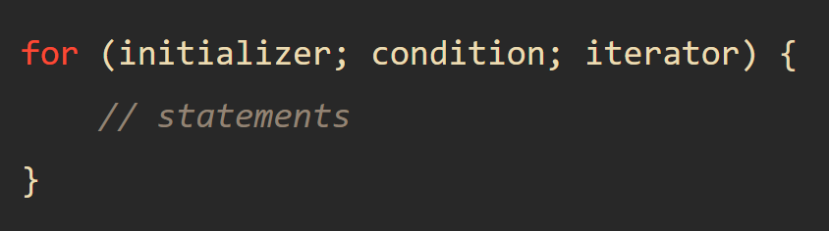
FOR LOOP

Slide 10
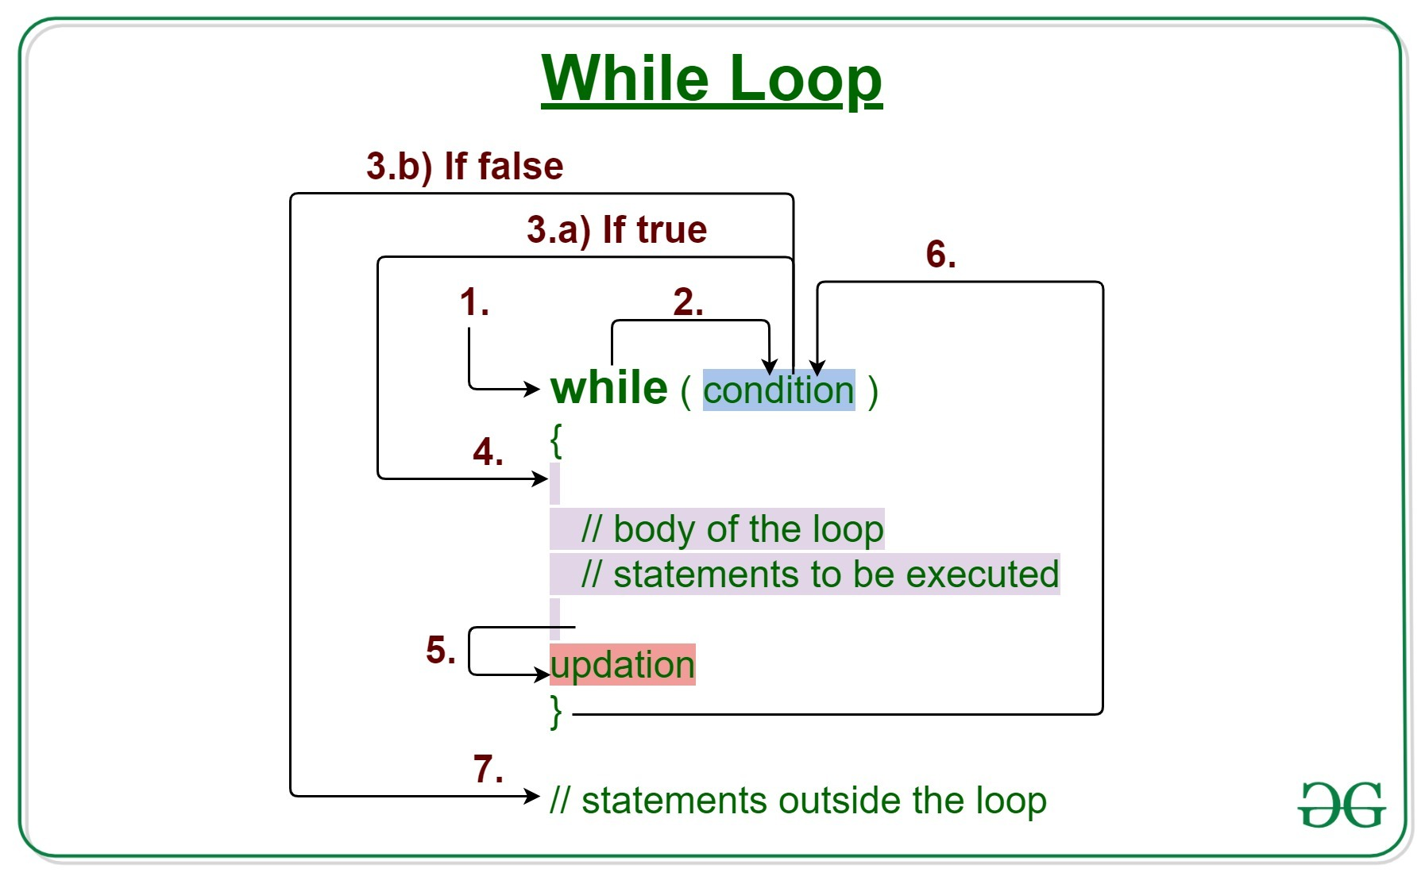

Slide 11
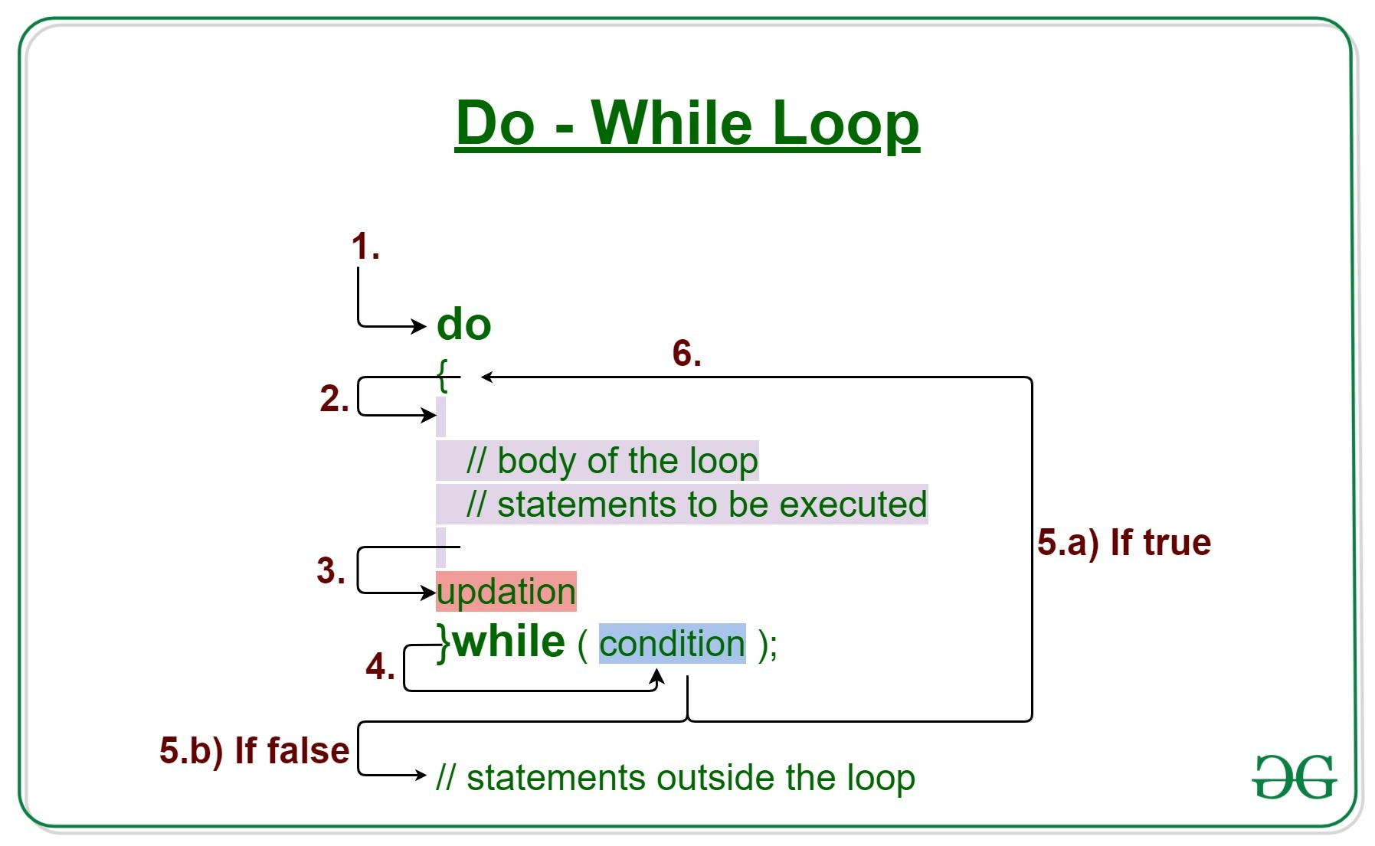

Slide 12
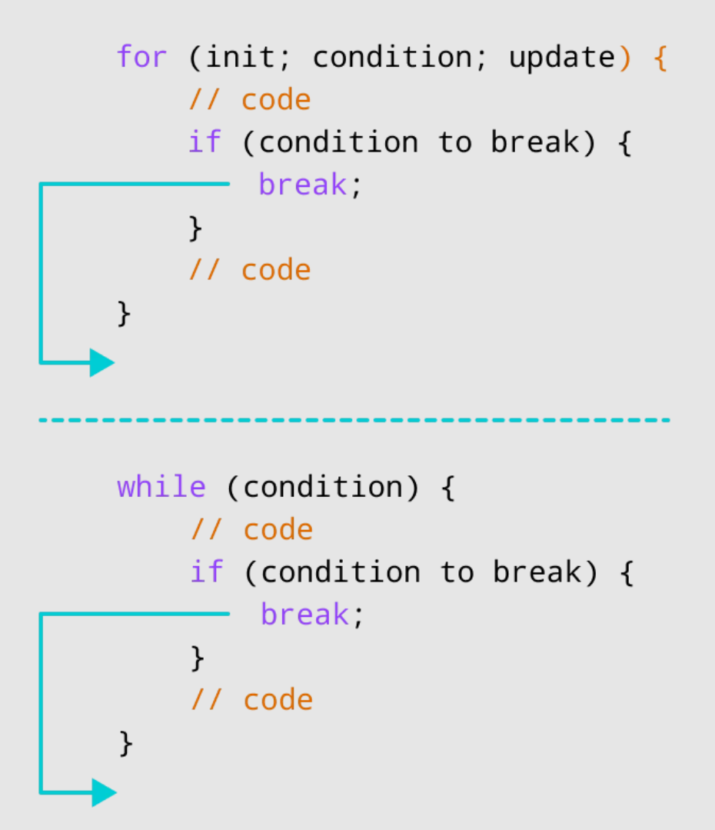
BREAK

Slide 13
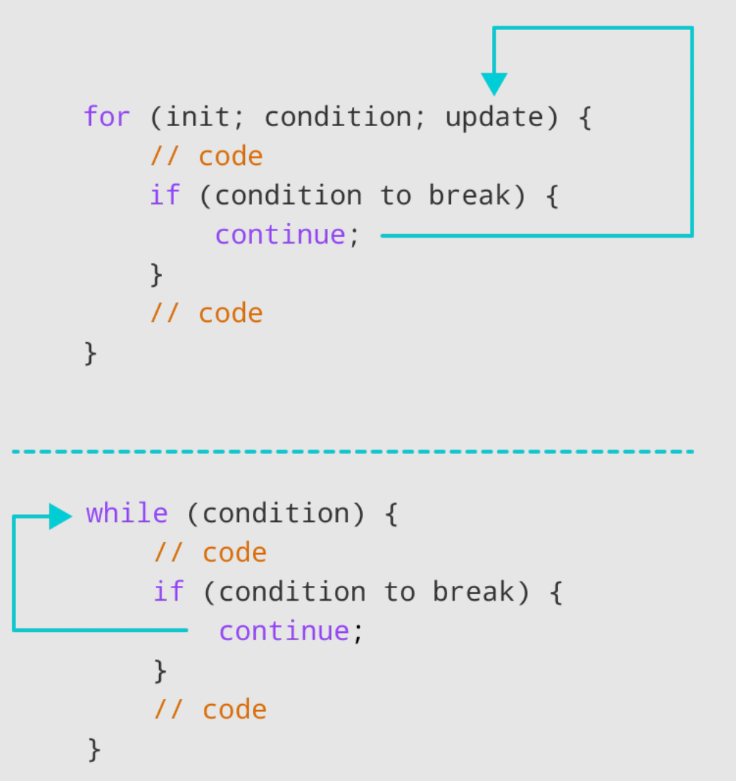
CONTINUE

Slide 14
3 Functions
JavaScript for React

Slide 15
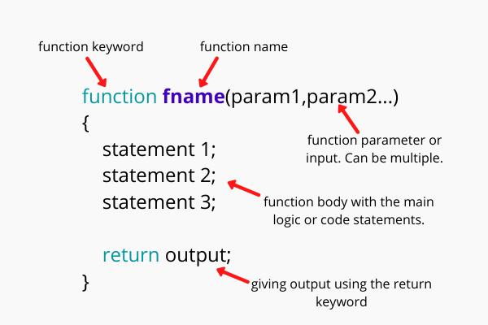
Function declaration

Slide 16
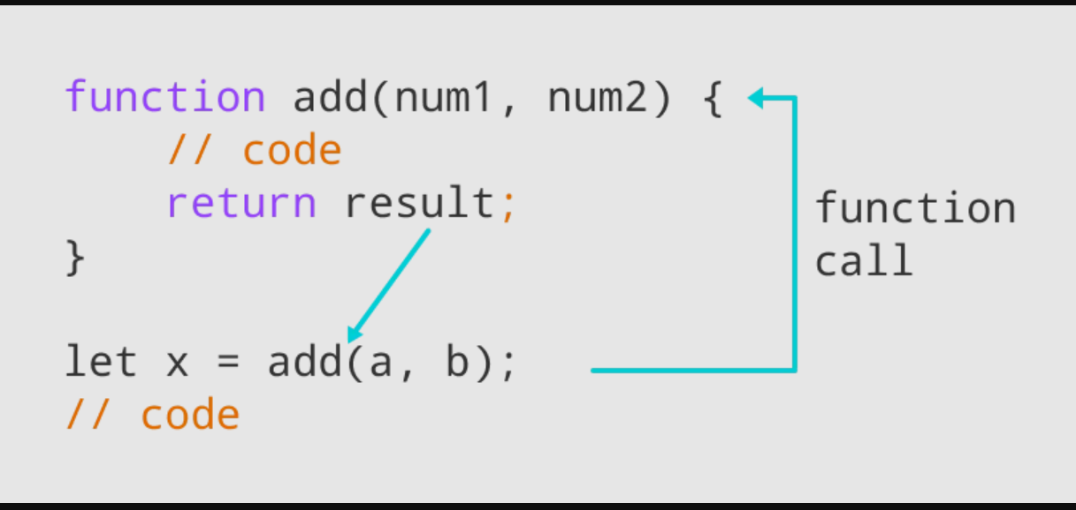
Function call / invocation
Parameters:
What the function receives from the main program
Arguments:
What the main program passes to the function

